Slide 1

Group 3
Municipality 9
Data Visualization
Pablo Alfaro - Niccolò Cloetta - Benjamín Cruz Infante - Camilo Mercado - Giacomo Salza

Slide 2
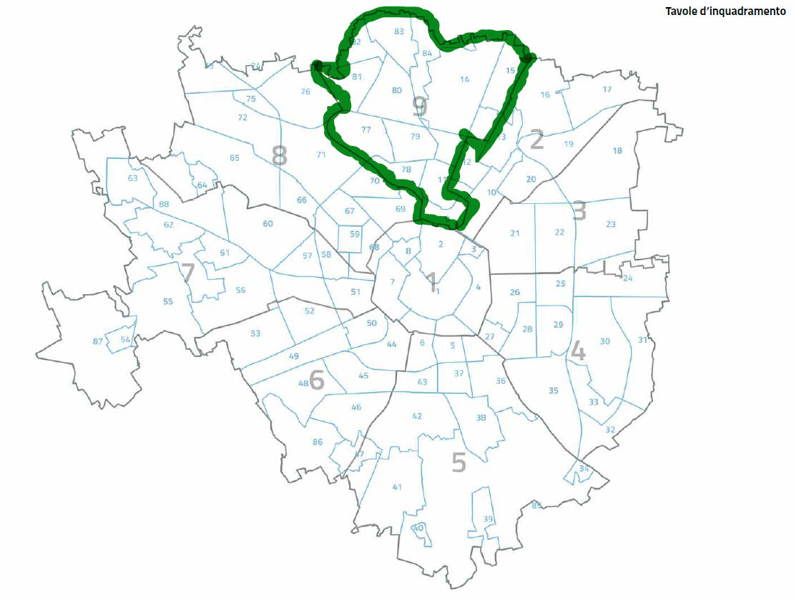
NIL’s Municipality 9
9. Porta Garibaldi - Porta Nuova
11. Isola
12. Maciachini-Maggiolina
13. Greco
14. Niguarda - Ca’ Granda
15. Bicocca
77. Bovisa
78. Farini
79. Dergano
80. Affori
81. Bovisasca
82. Comasina
83. Bruzzano
84. Parco Nord

Slide 3

Research Question
What are the most convenient and affordable areas for renting an Airbnb near POLIMI Bovisa (Municipality 9) for international students to stay meanwhile they are looking for a long term place?
We will illustrate different index generated with the Airbnb Database to get a general snapshot, focusing on help international students for the temporarily renting search

Slide 4
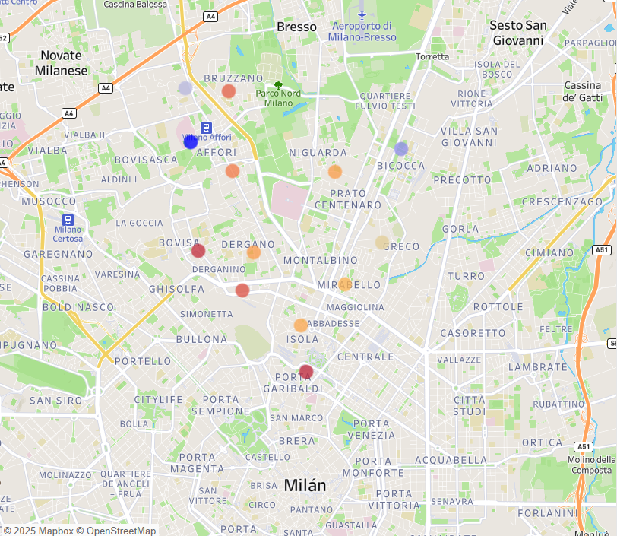
Value for Student Life Index
Steps of Index Creation
Cleaned the data for null values in essential fields
Selected price, distance, availability, review score, amenities
Coded each factor to be normalized on a 0-10 scale for comparability.
For example:
(Max Price - [Average Price]) / (Max Price - Min Price) * 10
Assigned scores to each neighborhood under specific factors, like lower price is better than higher price:
(MAX([Average Price]) - [Average Price]) / (MAX([Average Price]) - MIN([Average Price])) * 10
Assigned weights to each factor so that certain characteristics are more important than others:
Price: 30%, Distance: 25%, Review: 20%, Availability:15%, Amenities: 10%
Visualized through a heatmap, coloured by Value for Student Life Index Score on a scale from 1-10
Lowest = Garibaldi 3.69
Highest = Bovisasca 8.00

Slide 5
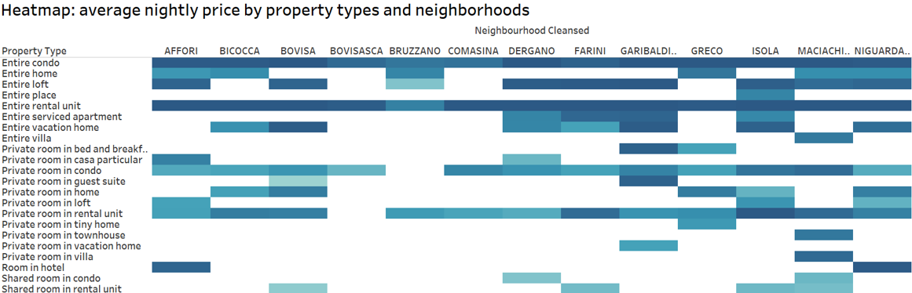
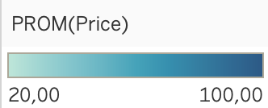
Separated valuation based on: place, price &
simple index of quality
Useful for international students because it allows them to:
Finding which combinations are budget-friendly and which are better suited for students with higher financial flexibility
Making data-driven decisions by matching budget, property types and neighborhoods preferences
Avg Price

Slide 6
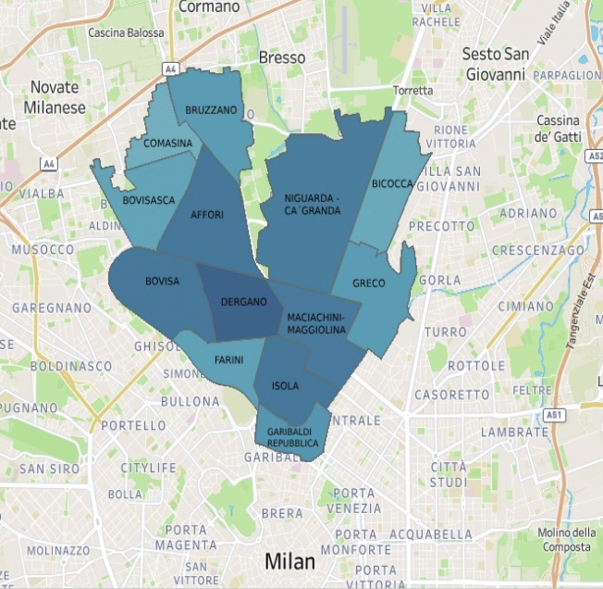

Simple value index
The choropleth map shows a general overview of the Average Simple Value Index for each neighborhood (NIL) within Municipality 9
Simple Value Index = Review score value / Price
The color intensity reflects the Average Simple Value Index for each NIL
Areas like Dergano, Bovisa, or Affori may offer better deals overall compared to others like Garibaldi or Farini, which are typically more expensive
Simple approach, it offers a quick and intuitive way to highlight NIL’s that combine quality and affordability
Avg Simple Value Index

Slide 7
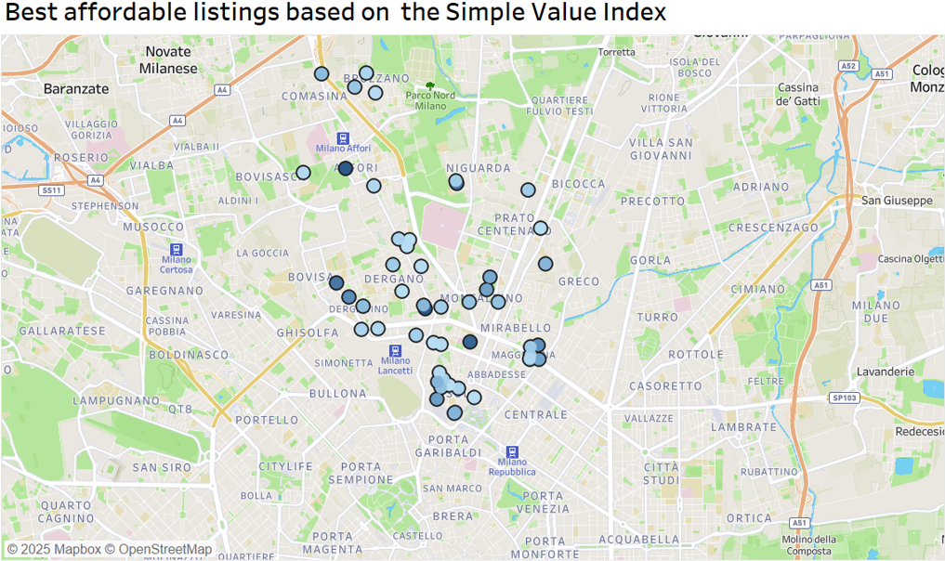
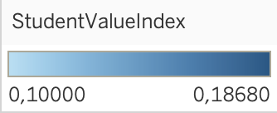
Simple value index: filtered
This point map shows individual listings, where darker blue circles indicate higher quality with a low price, making them ideal choices for students on a budget
For listing-level analysis, we excluded low-rated listings (review < 4.0) to avoid misleading results and focus only on acceptable quality options
Student’s benefits of this visualization:
They can easily spot specific high-value listings near the Bovisa area
It enables more granular, listing-level decision-making instead of general neighborhood trends
(*)Only listings priced between €20 and €100 per night (a realistic range for students) are shown
Avg Simple Value Index

Slide 8
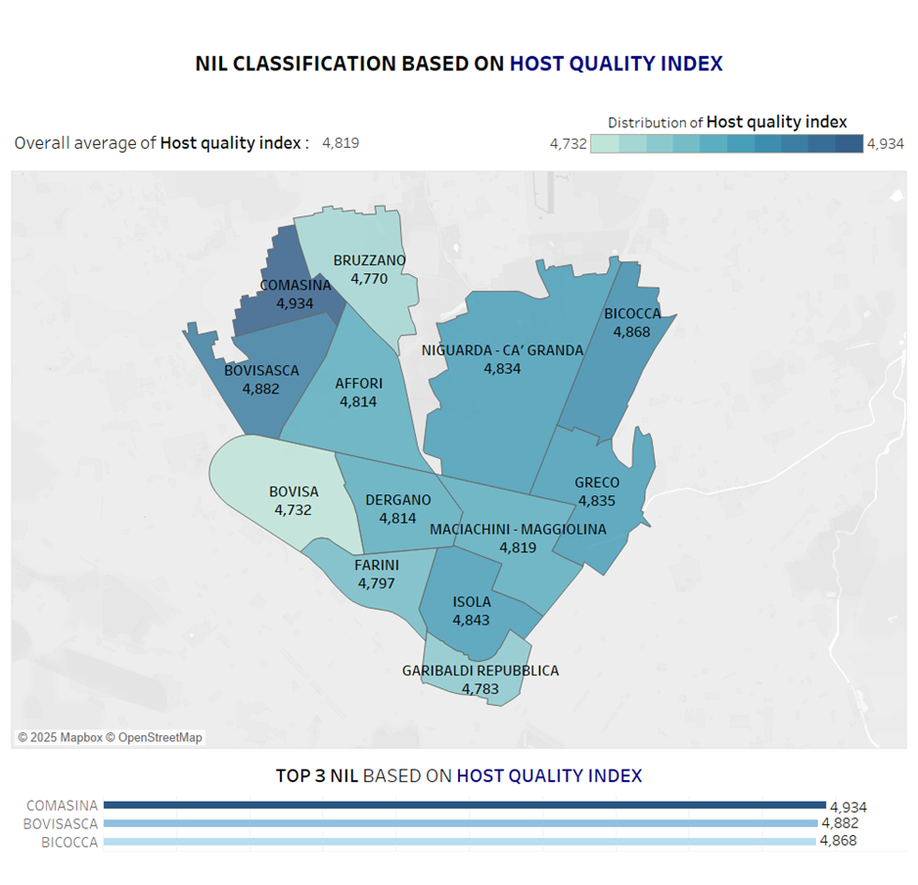

Best NIL Selection
Based On
Host Quality Index
Host Quality Index (Overall Average)
This index represents an average of four review scores related to the host, rated from 1 to 5, reflecting different aspects of the guest experience:
• Communication – clarity and responsiveness of the host
• Accuracy – match between the listing and reality
• Cleanliness – hygiene of the accommodation
• Check-in – ease and timeliness of the arrival process
(*) Only hosts with a minimum score of 4.5 are considered for the Host quality index Visualization

Slide 9
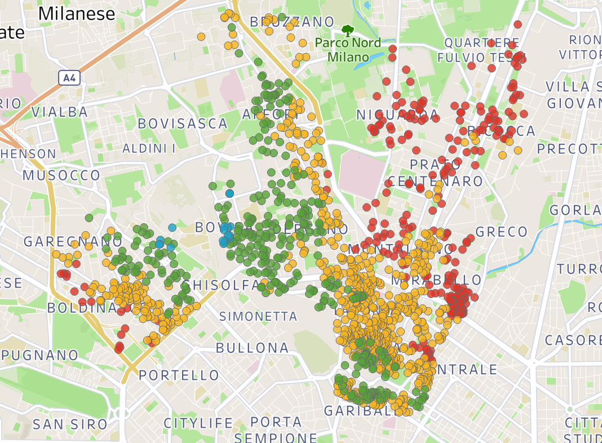
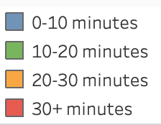

Connectivity to Politecnico di Milano - Bovisa Campus
Python function connected to Google Maps API that computes for each AirBnB the time taken to get to Polimi Bovisa
Behaving as expected, the closer to campus, the faster you get there
Along the train track, the time is significantly reduced

Slide 10
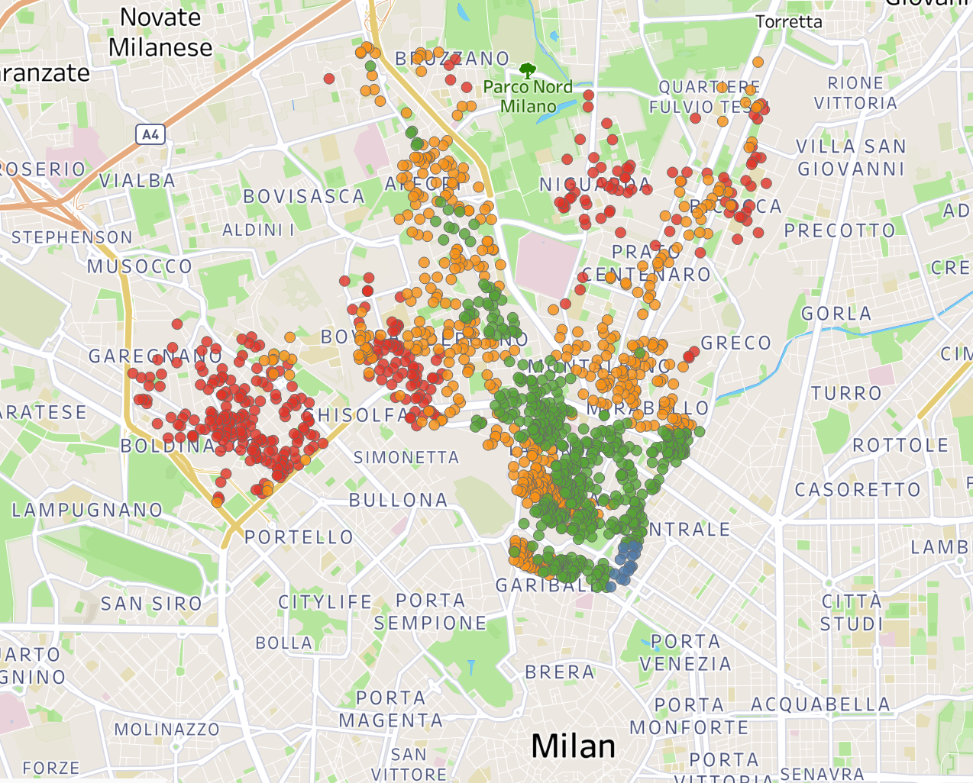
Connectivity to Duomo di Milano (City Center)
Python function connected to Google Maps API that computes for each AirBnB the time taken to get to Duomo
You can live almost up to Comasina and still be 17 minutes from Duomo…
Taking the same time as living in Garibaldi, or even less

Slide 11
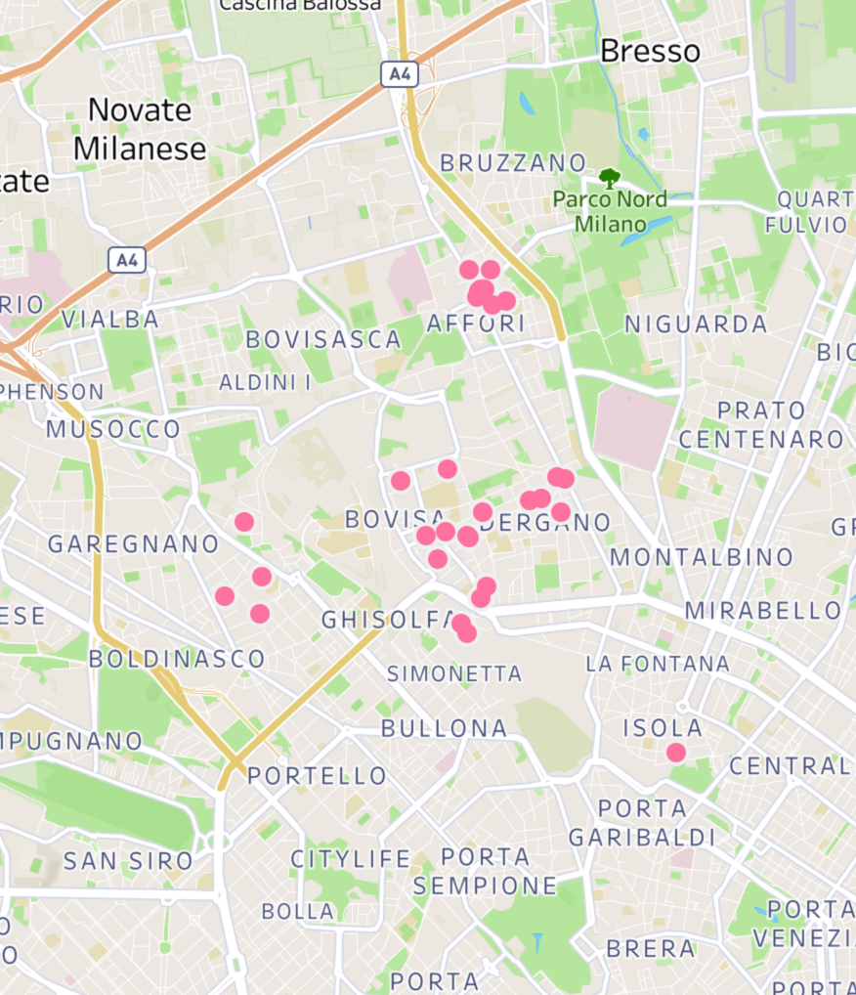

Hypothetical situation:
Felipe, from Uruguay and future student of Master BADS 2026, asks us for help finding a place for 30 to 90 days, he needs:
Entire Place
Suitable for one person (0-1 bedrooms & 1-2 bathrooms)
Willing to pay between 20 to 60 euros per night
Really care about the Host Quality (Index +4)
Lives in a neighbour at most 20 minutes away from Polimi

Slide 12
🔍 Key Conclusions
Municipality 9 Airbnb Insights for International Students
Life Quality Index visualizations (considering price, distance, availability, review score, amenities) provided a broader picture of student experience in different zones, beyond price alone → Bovisasca appears as top 1
The Simple Quality Index (Review Score / Price) revealed optimal value-for-money places, highlighting spots where students can find well-rated listings without overpaying → Dergano stands out in this dimension
Host Quality visualization allowed us to identify neighborhoods with consistently high host ratings, helping students choose listings with reliable service and communication → Comasina as the top 1 in this Index
Distance-based locations, closer to a train station in this NIL, imply less travel time to Bovisa
With all of the index above, we can make specific recommendations of places align with the needs and requirements of the different international students

Slide 13
Thank you!
And if you need help for a place in Municipality 9, do not hesitate to contact us 😉

